Slide 1


Quantum Espresso
Overview and Practical Guide
Dr. Dzade Nelson
The Pennsylvania State University

Slide 2





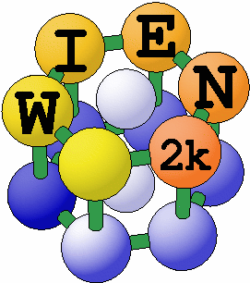



DFT codes/software
Spanish Initiative for Electronic Simulations with Thousands of Atoms
CAmbridge Serial Total Energy Package

Slide 3
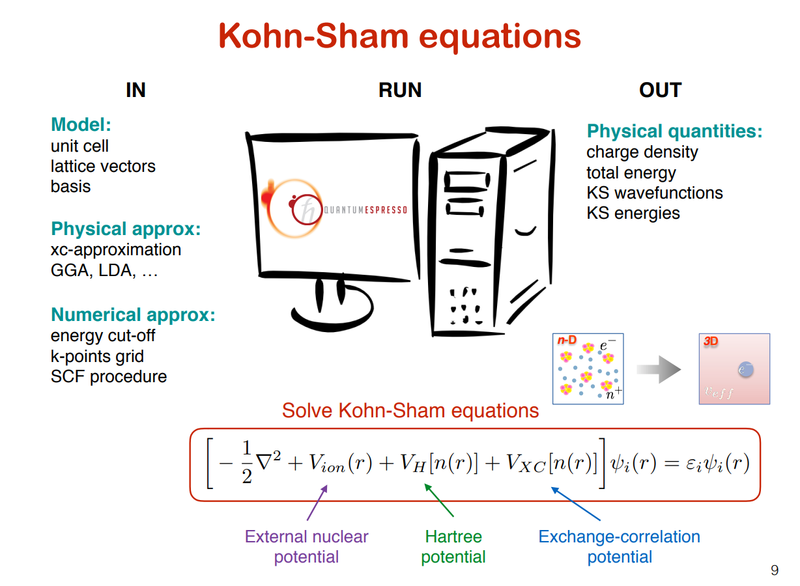

Slide 4









Structure of QE I/O file
Binary file
Text file
Text file
input.in
pw.x
output.out
Notepad++, Wordpad, vi, emacs, …
Notepad++, Wordpad, vi, emacs, …
pw.x < input.in
> output.out
(pw.exe for Windows users)
Data file
Text & data file
Binary file
tmp folder
band structure, phonon, charge density
pw.x, ph.x, pp.x,
…
Text file
new input.in
gnuplot, xmgrace, xcrysden, Vesta
pw.x < input.in > output.out (pw.exe for Windows users)

Slide 5
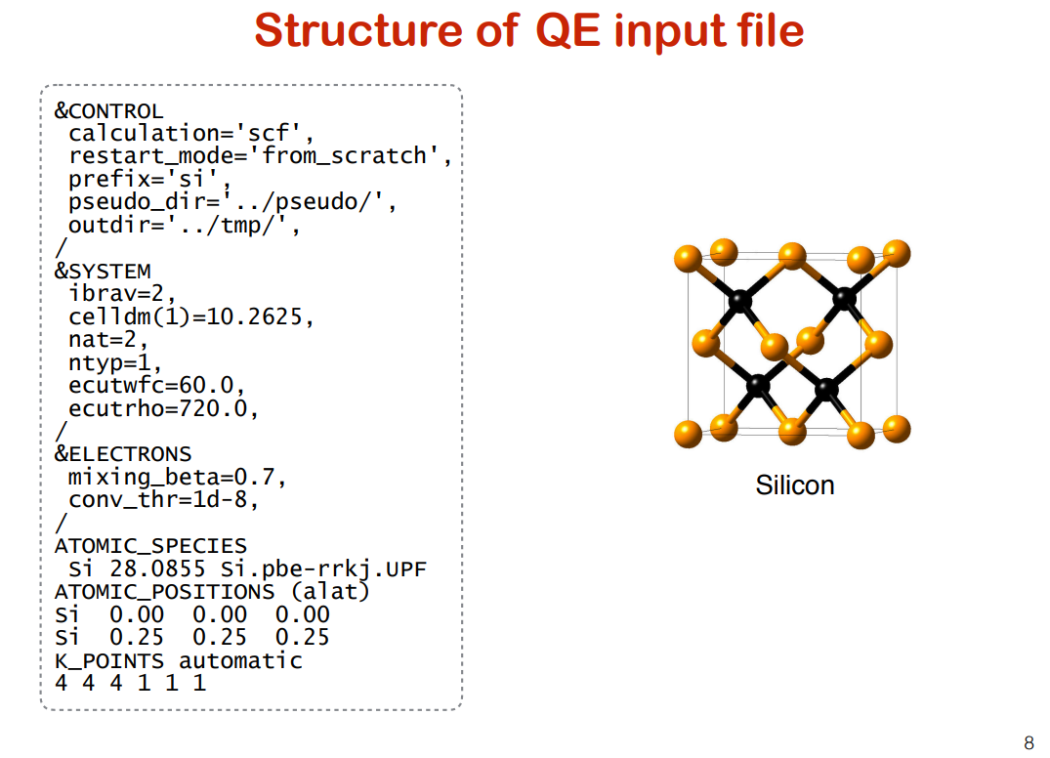

Slide 6
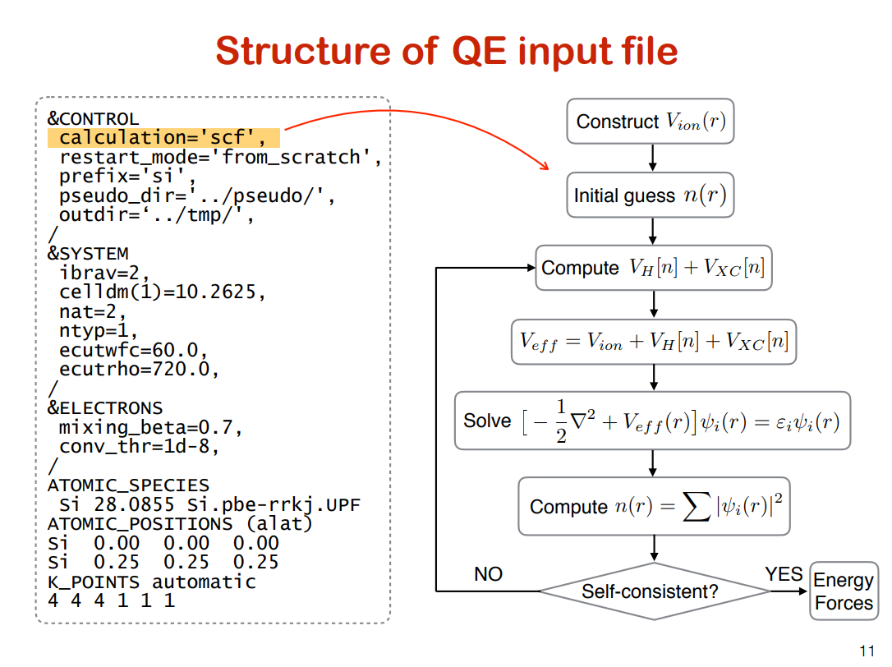

Slide 7
Structure of QE input file
&CONTROL
calculation='scf', restart_mode='from_scratch', prefix='si', pseudo_dir='../pseudo/', outdir=‘../tmp/',
/ &SYSTEM
ibrav | = 1 | (SC)
ibrav | = 2 | (FCC)
ibrav | = 4 | (Hexagonal)
…
ibrav=2,
celldm(1)=10.2625, nat=2,
ntyp=1, ecutwfc=60.0, ecutrho=720.0,
/ &ELECTRONS
mixing_beta=0.7, conv_thr=1d-8,
/ ATOMIC_SPECIES
Si 28.0855 Si.pbe-rrkj.UPF ATOMIC_POSITIONS (alat)
simple cubic: v1 = a(1,0,0)
v2 = v3 = face | a(0,1,0) a(0,0,1) centered | cubic:
v1 = | (a/2)(-1,0,1)
v2 = | (a/2)(0,1,1)
v3 = | (a/2)(-1,1,0)
Si | 0.00 | 0.00 | 0.00
Si | 0.25 | 0.25 | 0.25
K_POINTS automatic 4 4 4 1 1 1

Slide 8
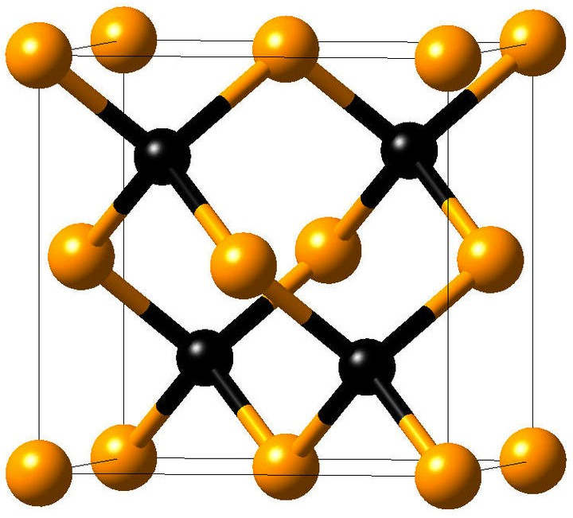
Structure of QE input file
&CONTROL
calculation='scf', restart_mode='from_scratch', prefix='si', pseudo_dir='../pseudo/', outdir='../tmp/',
/
FCC structure
&SYSTEM
ibrav=2,
unit bohr
celldm(1)=10.2625,
a
nat=2, ntyp=1, ecutwfc=60.0,
ecutrho=720.0,
/ &ELECTRONS
mixing_beta=0.7, conv_thr=1d-8,
/ ATOMIC_SPECIES
Si 28.0855 Si.pbe-rrkj.UPF ATOMIC_POSITIONS (alat)
a
a
face centered cubic: v1 = (a/2)(-1,0,1)
v2 = (a/2)(0,1,1)
v3 = (a/2)(-1,1,0)
Si | 0.00 | 0.00 | 0.00
Si | 0.25 | 0.25 | 0.25
K_POINTS automatic 4 4 4 1 1 1
1 bohr = 0.529177 Å

Slide 9

Structure of QE input file
&CONTROL
calculation='scf', restart_mode='from_scratch', prefix='si', pseudo_dir='../pseudo/', outdir='../tmp/',
/ &SYSTEM
ibrav=2,
FCC structure
celldm(1)=10.2625,
a
nat=2,
ntyp=1, ecutwfc=60.0, ecutrho=720.0,
/ &ELECTRONS
mixing_beta=0.7, conv_thr=1d-8,
/ ATOMIC_SPECIES
Si 28.0855 Si.pbe-rrkj.UPF ATOMIC_POSITIONS (alat)
a
a
Si | 0.00 | 0.00 | 0.00
Si | 0.25 | 0.25 | 0.25
K_POINTS automatic 4 4 4 1 1 1

Slide 10
Structure of QE input file
&CONTROL
calculation='scf', restart_mode='from_scratch', prefix='si', pseudo_dir='../pseudo/', outdir='../tmp/',
/ &SYSTEM
ibrav=2, celldm(1)=10.2625,
FCC structure
a
nat=2,
ntyp=1,
ecutwfc=60.0, ecutrho=720.0,
/ &ELECTRONS
mixing_beta=0.7, conv_thr=1d-8,
/
a
a
Silicon
ATOMIC_SPECIES
Si 28.0855 Si.pbe-rrkj.UPF
ATOMIC_POSITIONS (alat)
K_POINTS automatic 4 4 4 1 1 1
Si | 0.00 | 0.00 | 0.00
Si | 0.25 | 0.25 | 0.25

Slide 11
Structure of QE input file
&CONTROL
calculation='scf', restart_mode='from_scratch', prefix='si', pseudo_dir='../pseudo/', outdir='../tmp/',
/ &SYSTEM
ibrav=2, celldm(1)=10.2625,
FCC structure
a
nat=2,
ntyp=1,
ecutwfc=60.0, ecutrho=720.0,
/ &ELECTRONS
mixing_beta=0.7, conv_thr=1d-8,
/
a
a
Silicon
ATOMIC_SPECIES
Si 28.0855 Si.pbe-rrkj.UPF ATOMIC_POSITIONS (alat)
Mass of Si
K_POINTS automatic 4 4 4 1 1 1
Si | 0.00 | 0.00 | 0.00
Si | 0.25 | 0.25 | 0.25

Slide 12
Structure of QE input file
&CONTROL
calculation='scf', restart_mode='from_scratch', prefix='si', pseudo_dir='../pseudo/', outdir='../tmp/',
/ &SYSTEM
ibrav=2, celldm(1)=10.2625,
FCC structure
PP file
a
nat=2,
ntyp=1,
ecutwfc=60.0, ecutrho=720.0,
/ &ELECTRONS
mixing_beta=0.7, conv_thr=1d-8,
/
a
a
Silicon
ATOMIC_SPECIES
Si 28.0855 Si.pbe-rrkj.UPF ATOMIC_POSITIONS (alat)
K_POINTS automatic 4 4 4 1 1 1
Si | 0.00 | 0.00 | 0.00
Si | 0.25 | 0.25 | 0.25

Slide 13
Structure of QE input file
&CONTROL
calculation='scf', restart_mode='from_scratch', prefix='si', pseudo_dir='../pseudo/', outdir='../tmp/',
/ &SYSTEM
ibrav=2, celldm(1)=10.2625, nat=2,
ntyp=1, ecutwfc=60.0, ecutrho=720.0,
/ &ELECTRONS
mixing_beta=0.7, conv_thr=1d-8,
/ ATOMIC_SPECIES
Si 28.0855 Si.pbe-rrkj.UPF ATOMIC_POSITIONS (alat)
K_POINTS automatic 4 4 4 1 1 1
FCC structure
a
a
a
atomic positions are in cartesian coordinates, in units of the lattice parameter.
Si | 0.00 | 0.00 | 0.00
Si | 0.25 | 0.25 | 0.25

Slide 14
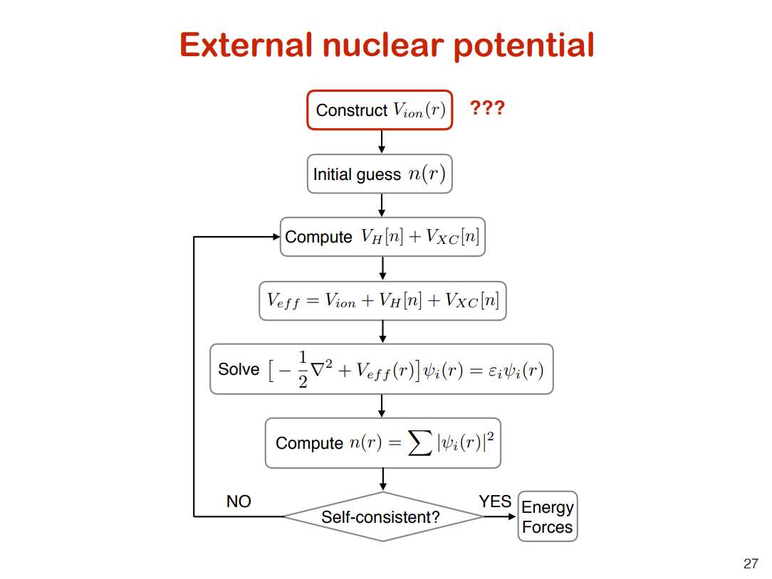

Slide 15
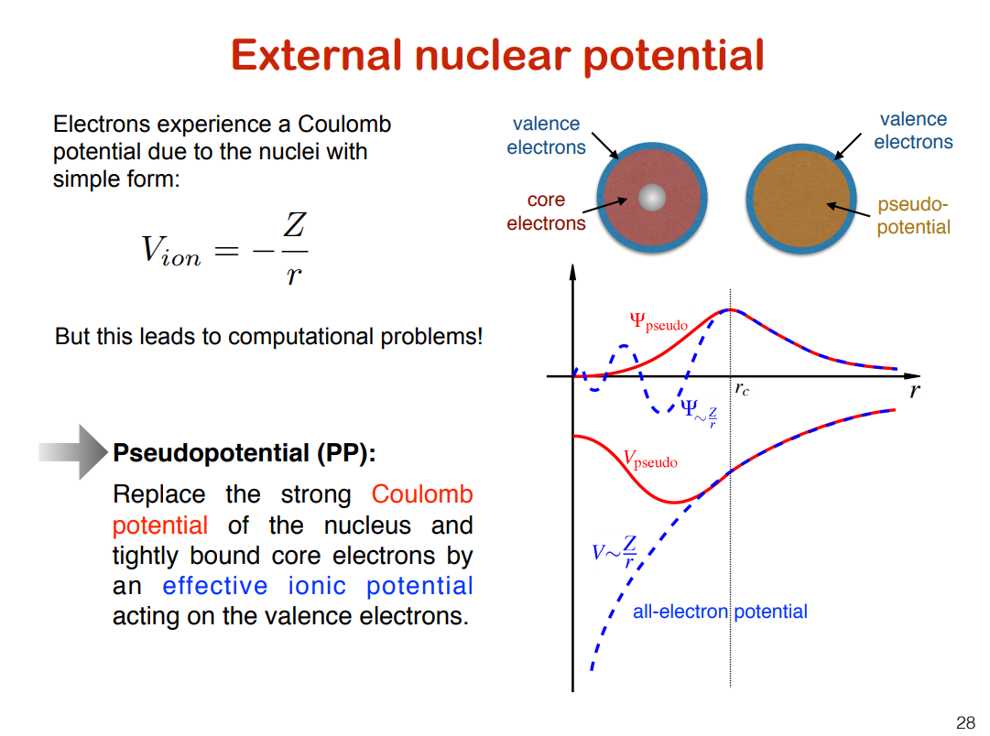
Real potential and wave function are shown in blue
Pseudopotential and pseudo wave functions in red
Outside the cutoff region (vertical black line) the two are identical
The rapidly changing potential field near the atomic core is replaced by a smoother function that simulates the potential field far from the core very well. By doing so, it requires less number plane wave basis for wavefunction expansion.

Slide 16
Pseudopotential
&CONTROL
calculation='scf', restart_mode='from_scratch', prefix='si', pseudo_dir='../pseudo/', outdir='../tmp/',
/ &SYSTEM
ibrav=2, celldm(1)=10.2625, nat=2,
ntyp=1, ecutwfc=60.0, ecutrho=720.0,
/ &ELECTRONS
mixing_beta=0.7, conv_thr=1d-8,
/ ATOMIC_SPECIES
Si 28.0855 Si.pbe-rrkj.UPF
Name of the pseudopotential file
ATOMIC_POSITIONS (alat)
Si | 0.00 | 0.00 | 0.00
Si | 0.25 | 0.25 | 0.25
K_POINTS automatic 4 4 4 1 1 1

Slide 17
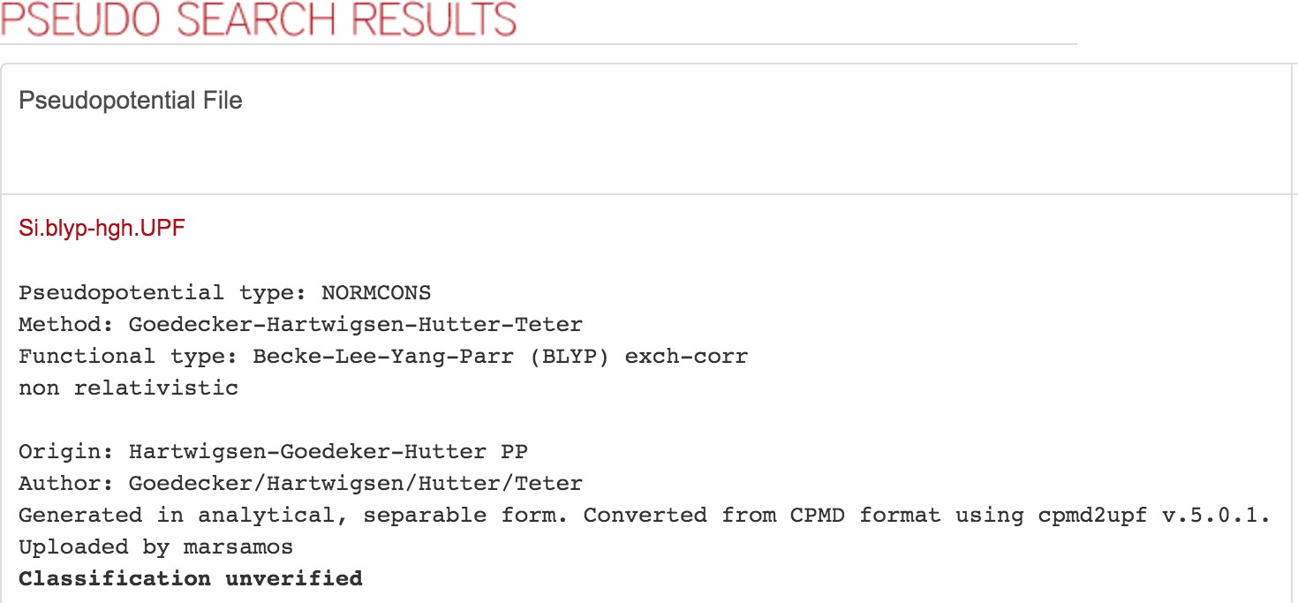
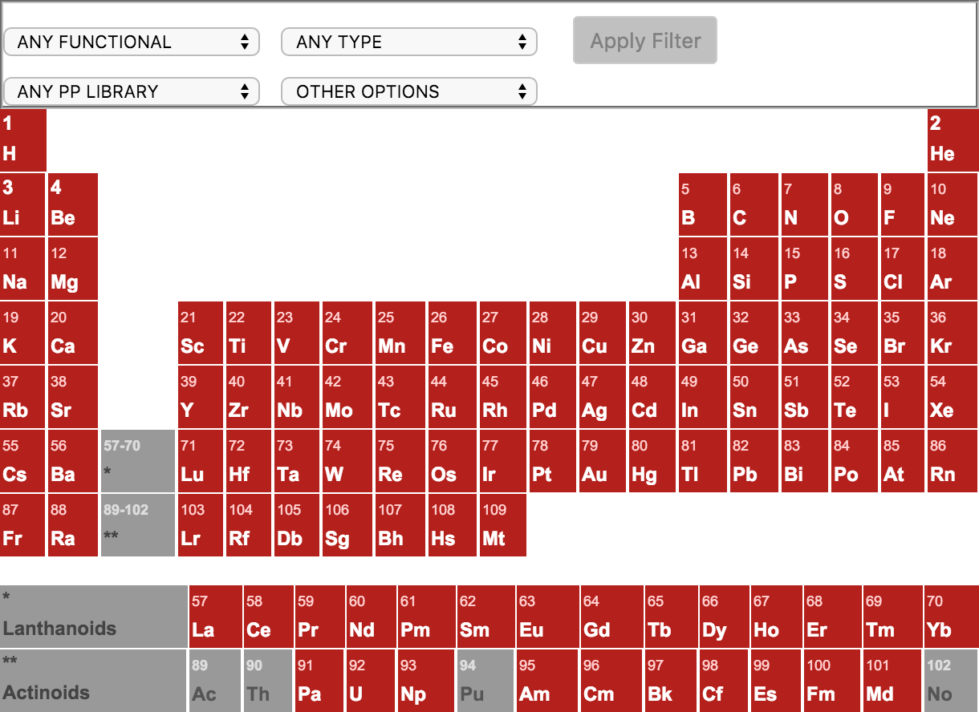
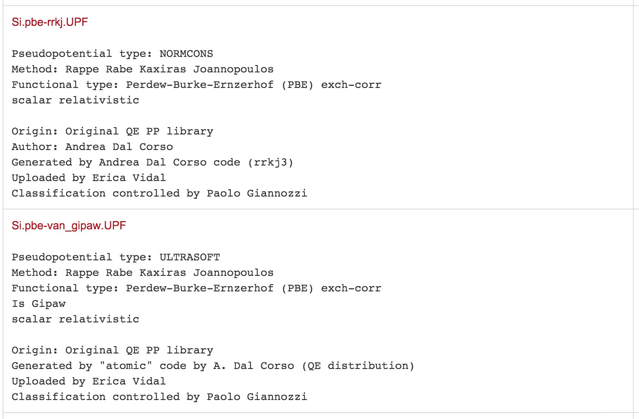
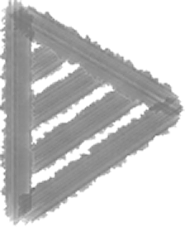
How to get pseudopotential
http://www.quantum-espresso.org/pseudopotentials/
Si.pbe-rrkj.UPF
type of exchange- correlation functional type of pseudopotential

Slide 18
Pseudopotential
&CONTROL
calculation='scf', restart_mode='from_scratch', prefix='si',
Si.pbe-rrkj.UPF
<PP_INFO>
Generated using Andrea Dal Corso code (rrkj3) Author: Andrea Dal Corso Generation date: unknown Info: Si PBE 3s2 3p2 RRKJ3
0 The Pseudo was generated with a Non-Relativistic Calculation
pseudo_dir='../pseudo/',
2.50000000000E+00 nl pn l occ |  |  | Local Potential cutoff radius Rcut Rcut US |  | E pseu
3S 1 | 0 | 2.00 | 2.50000000000 | 2.60000000000 | 0.00000000000
3S 1 | 0 | 0.00 | 2.50000000000 | 2.60000000000 | 0.00000000000
3P 2 | 1 | 2.00 | 2.50000000000 | 2.70000000000 | 0.00000000000
3D 3 | 2 | 0.00 | 2.50000000000 | 2.50000000000 | 0.00000000000
outdir='../tmp/',
/ &SYSTEM
ibrav=2, celldm(1)=10.2625, nat=2,
ntyp=1, ecutwfc=60.0, ecutrho=720.0,
/ &ELECTRONS
mixing_beta=0.7, conv_thr=1d-8,
/ ATOMIC_SPECIES
Si 28.0855 Si.pbe-rrkj.UPF ATOMIC_POSITIONS (alat)
K_POINTS automatic 4 4 4 1 1 1
</PP_INFO>
<PP_HEADER>
0 |  |  | Version Number
Si |  |  | Element
NC |  |  | Norm - Conserving pseudopotential
F |  |  | Nonlinear Core Correction
SLA PW | PBE | PBE | PBE Exchange-Correlation functional
Z valence Total energy
0.0000000 0.0000000 Suggested cutoff for wfc and rho
Max angular momentum component Number of points in mesh
Number of Wavefunctions, Number of Projectors nl l occ
3S 0 2.00
3P 1 2.00
4.00000000000
-7.47480832270
2
883
2
3
Wavefunctions
</PP_HEADER>
<PP_MESH>
<PP_R>
1.77053726905E-04 | 1.79729551320E-04 | 1.82445815642E-04 | 1.85203131043E-04
1.88002117930E-04 | 1.90843406086E-04 | 1.93727634813E-04 | 1.96655453076E-04
1.99627519645E-04 | 2.02644503249E-04 | 2.05707082721E-04 | 2.08815947154E-04
2.11971796056E-04 | 2.15175339506E-04 | 2.18427298316E-04 | 2.21728404189E-04
2.25079399889E-04 | 2.28481039403E-04 | 2.31934088115E-04 | 2.35439322975E-04
2.38997532677E-04 | 2.42609517831E-04 | 2.46276091150E-04 | 2.49998077629E-04
2.53776314730E-04 | 2.57611652573E-04 | 2.61504954124E-04 | 2.65457095393E-04
2.69468965628E-04 | 2.73541467517E-04 | 2.77675517391E-04 | 2.81872045428E-04
2.86131995864E-04 | 2.90456327206E-04 | 2.94846012447E-04 | 2.99302039285E-04
3.03825410344E-04 | 3.08417143402E-04 | 3.13078271619E-04 | 3.17809843768E-04
3.22612924472E-04 | 3.27488594446E-04 | 3.32437950735E-04 | 3.37462106965E-04
3.42562193593E-04 | 3.47739358159E-04 | 3.52994765549E-04 | 3.58329598249E-04
Si | 0.00 | 0.00 | 0.00
Si | 0.25 | 0.25 | 0.25

Slide 19
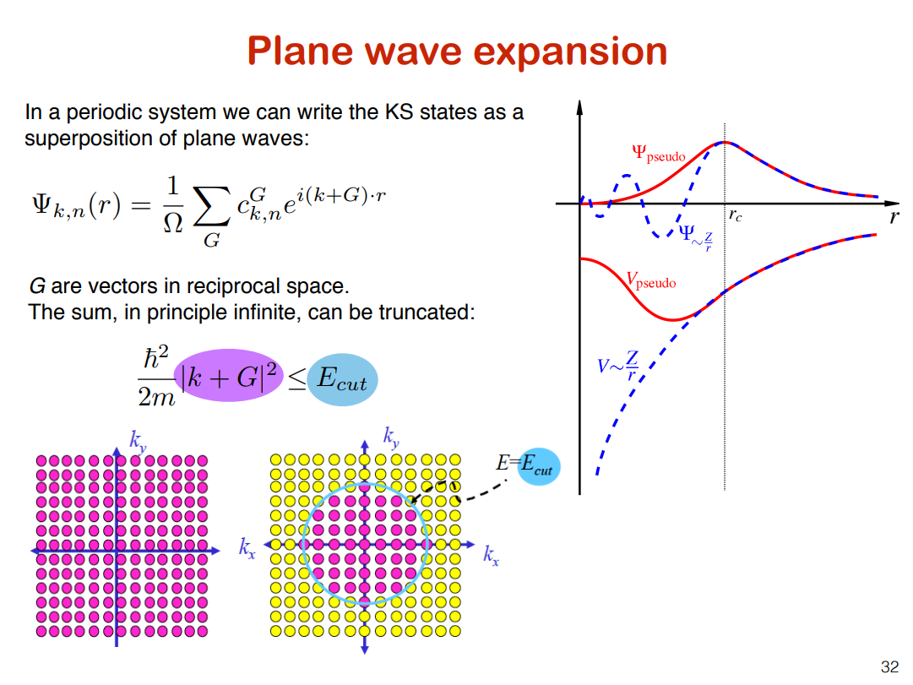

Slide 20
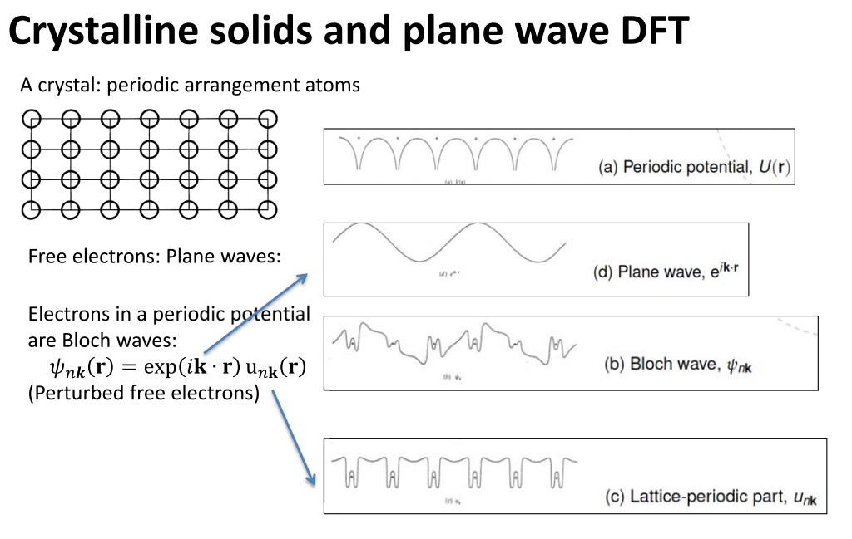

Slide 21
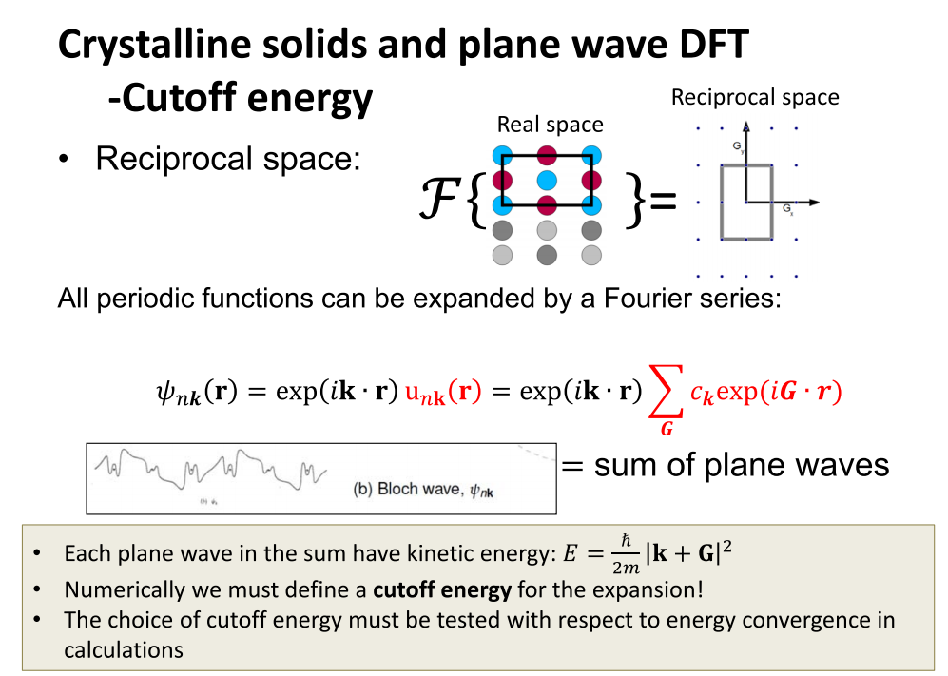

Slide 22
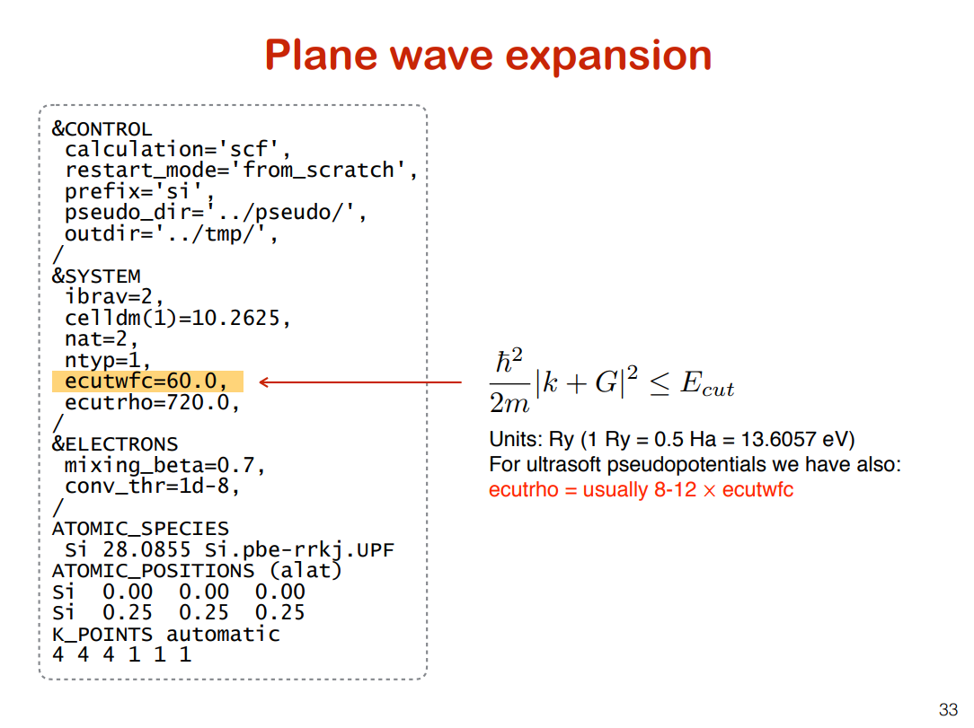

Slide 23
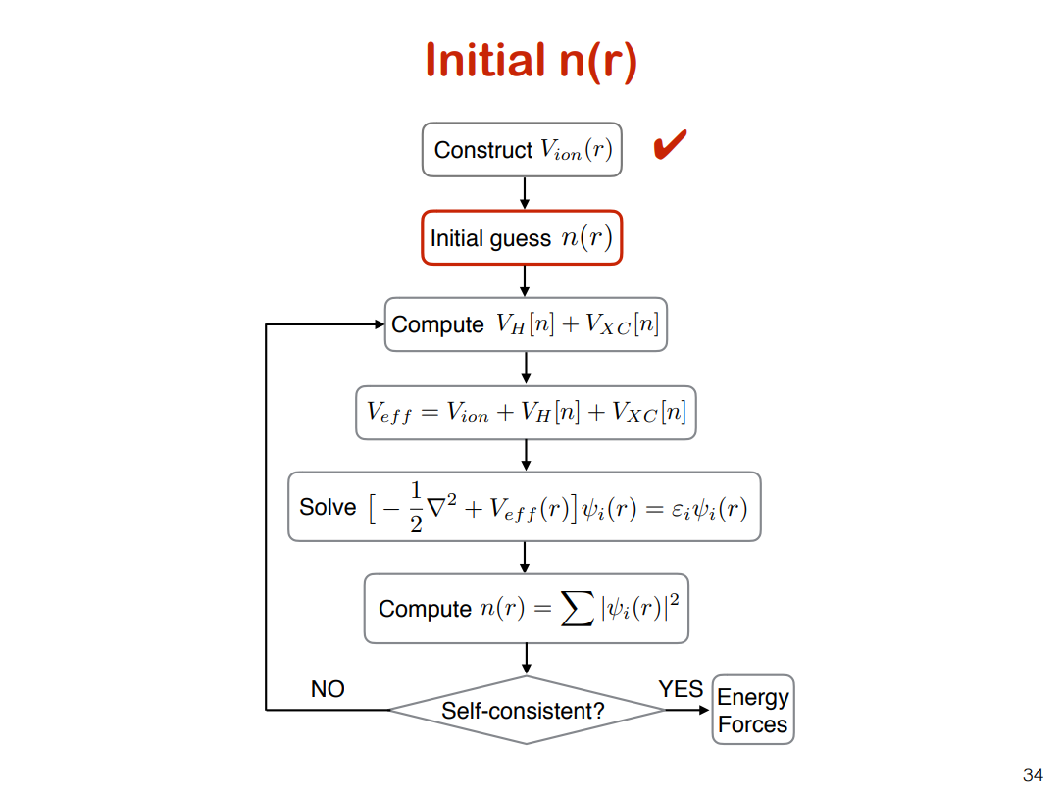

Slide 24
Initial n(r)
&CONTROL
calculation='scf', restart_mode='from_scratch', prefix='si', pseudo_dir='../pseudo/', outdir='../tmp/',
/ &SYSTEM
ibrav=2, celldm(1)=10.2625, nat=2,
ntyp=1, ecutwfc=60.0, ecutrho=720.0,
/
&ELECTRONS
startingwfc
= ‘atomic’(DEFAULT)
= ‘random’
= ‘file’
mixing_beta=0.7, conv_thr=1d-8,
/ ATOMIC_SPECIES
Si 28.0855 Si.pbe-rrkj.UPF ATOMIC_POSITIONS (alat)
K_POINTS automatic 4 4 4 1 1 1
Si | 0.00 | 0.00 | 0.00
Si | 0.25 | 0.25 | 0.25

Slide 25
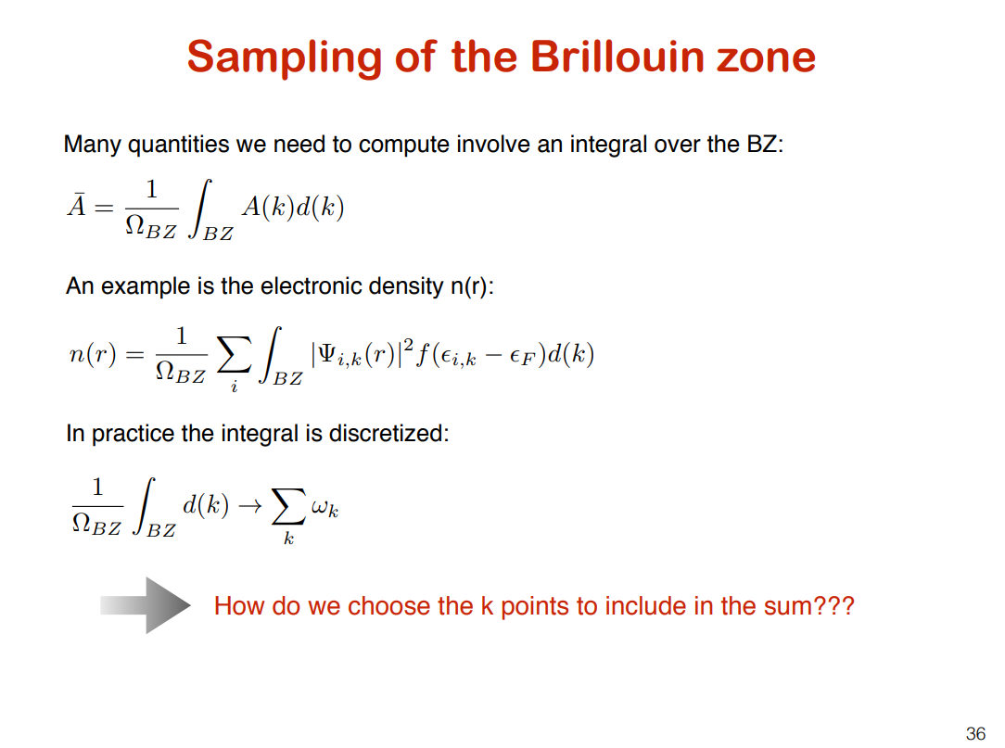

Slide 26
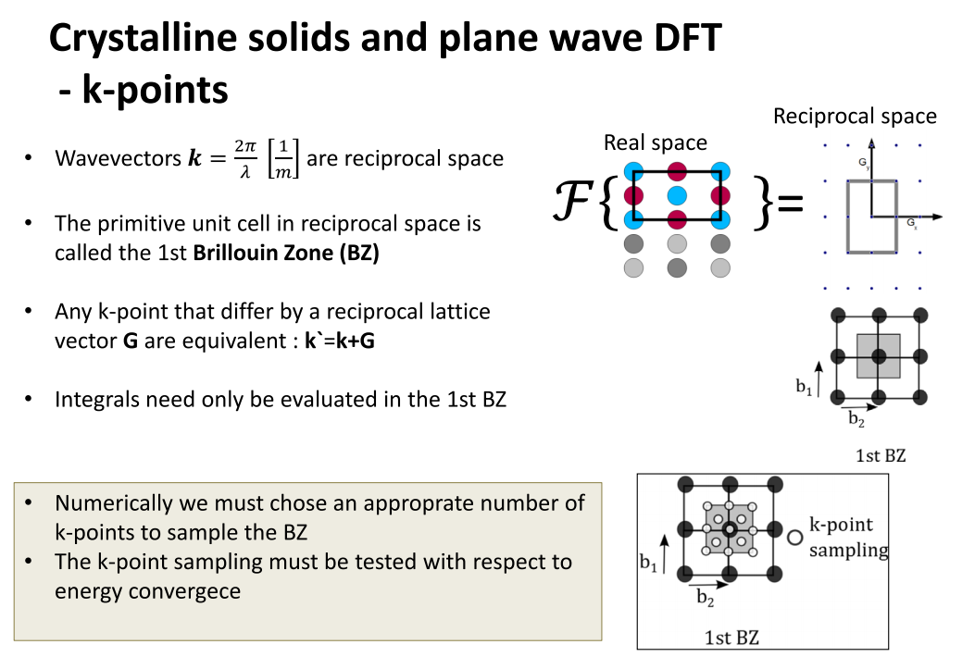

Slide 27
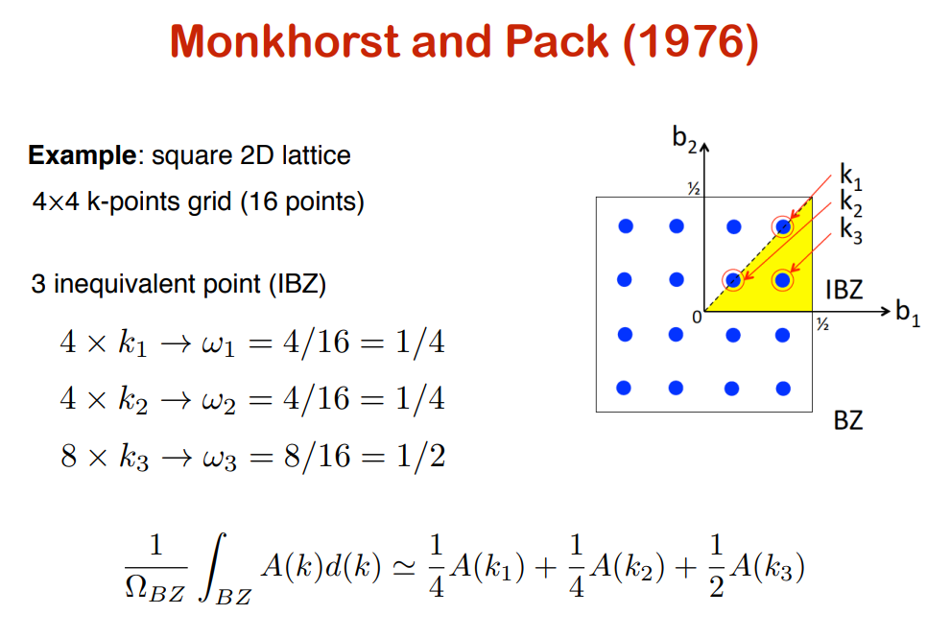

Slide 28
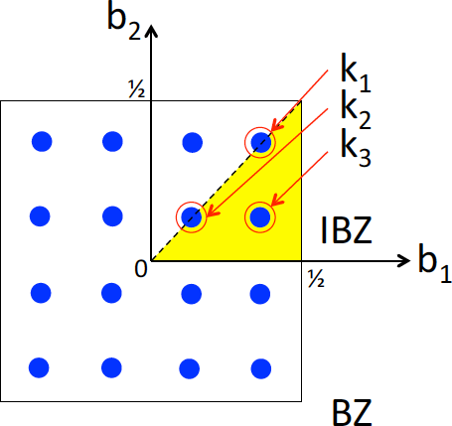
Sampling of the Brillouin zone
&CONTROL
calculation='scf', restart_mode='from_scratch', prefix='si', pseudo_dir='../pseudo/', outdir='../tmp/',
/ &SYSTEM
ibrav=2, celldm(1)=10.2625, nat=2,
ntyp=1, ecutwfc=60.0, ecutrho=720.0,
/ &ELECTRONS
mixing_beta=0.7, conv_thr=1d-8,
/ ATOMIC_SPECIES
Si 28.0855 Si.pbe-rrkj.UPF ATOMIC_POSITIONS (alat)
K_POINTS automatic
nk1, nk2, nk3, k1, k2, k3
nk1, nk2, nk3 as in Monkhorst-Pack grids k1, k2, k3 must be 0 ( no offset ) or 1 ( grid displaced by half a grid step in the corresponding direction )
Si 0.00 0.00 0.00
Si 0.25 0.25 0.25
K_POINTS automatic
4 | 4 | 4 | 1 | 1 | 1

Slide 29
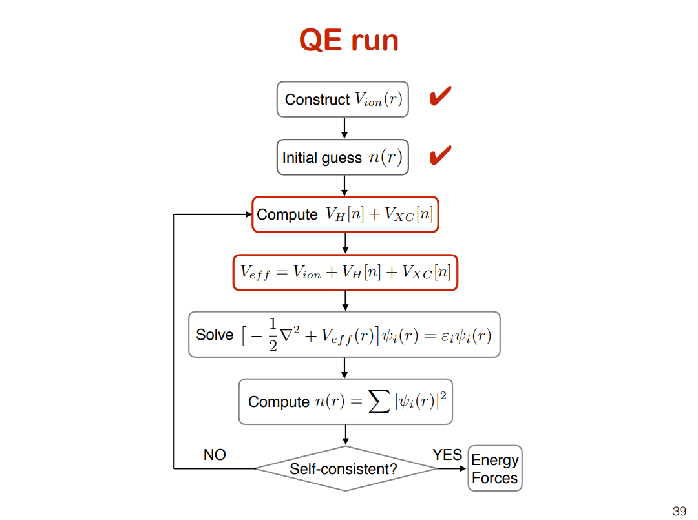

Slide 30
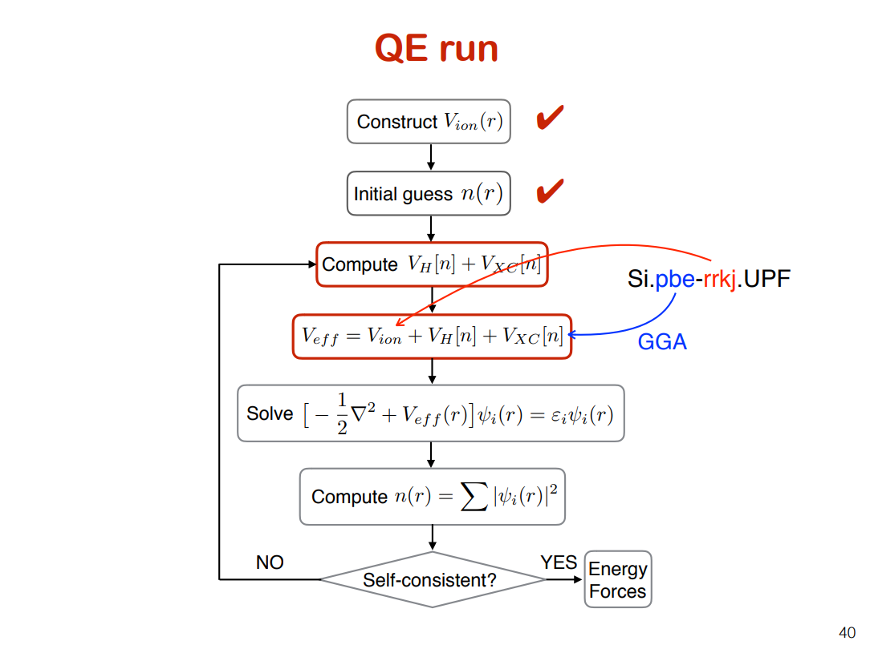

Slide 31
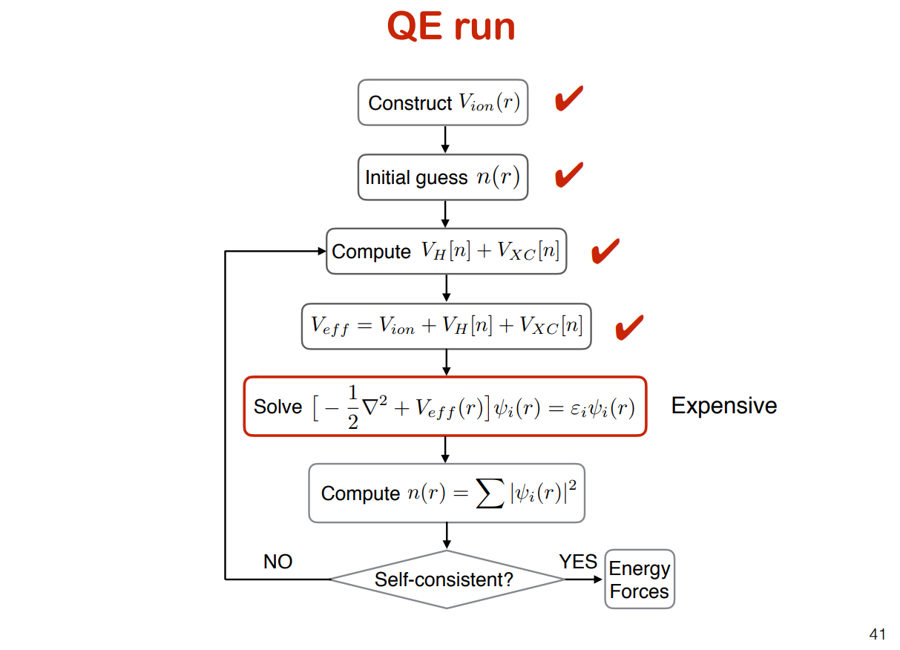

Slide 32
Solve wave equation
&CONTROL
calculation='scf', restart_mode='from_scratch', prefix='si', pseudo_dir='../pseudo/', outdir='../tmp/',
/ &SYSTEM
ibrav=2, celldm(1)=10.2625, nat=2,
ntyp=1, ecutwfc=60.0, ecutrho=720.0,
/
&ELECTRONS
diagonalization = ‘david’ (DEFAULT)
= ‘cg’
mixing_beta=0.7, conv_thr=1d-8,
/ ATOMIC_SPECIES
Si 28.0855 Si.pbe-rrkj.UPF ATOMIC_POSITIONS (alat)
K_POINTS automatic 4 4 4 1 1 1
Si | 0.00 | 0.00 | 0.00
Si | 0.25 | 0.25 | 0.25

Slide 33
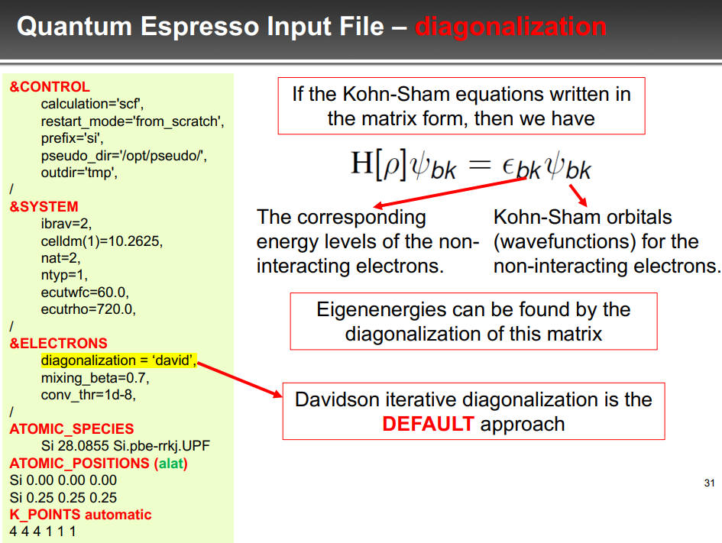

Slide 34
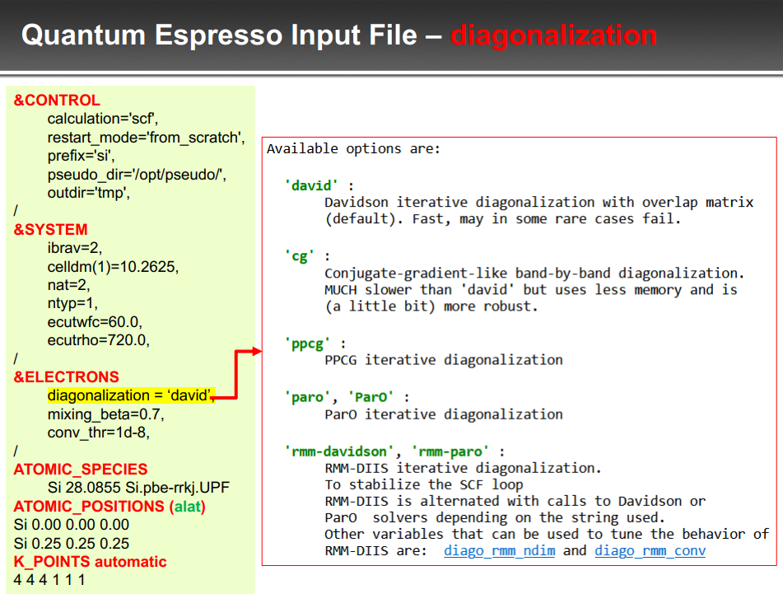

Slide 35
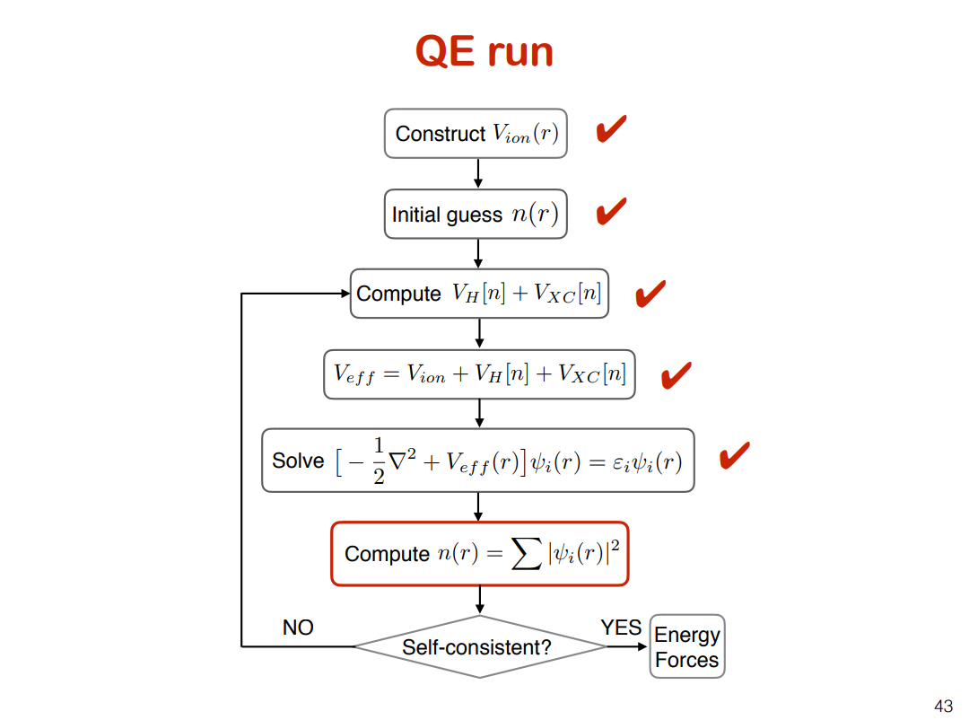

Slide 36
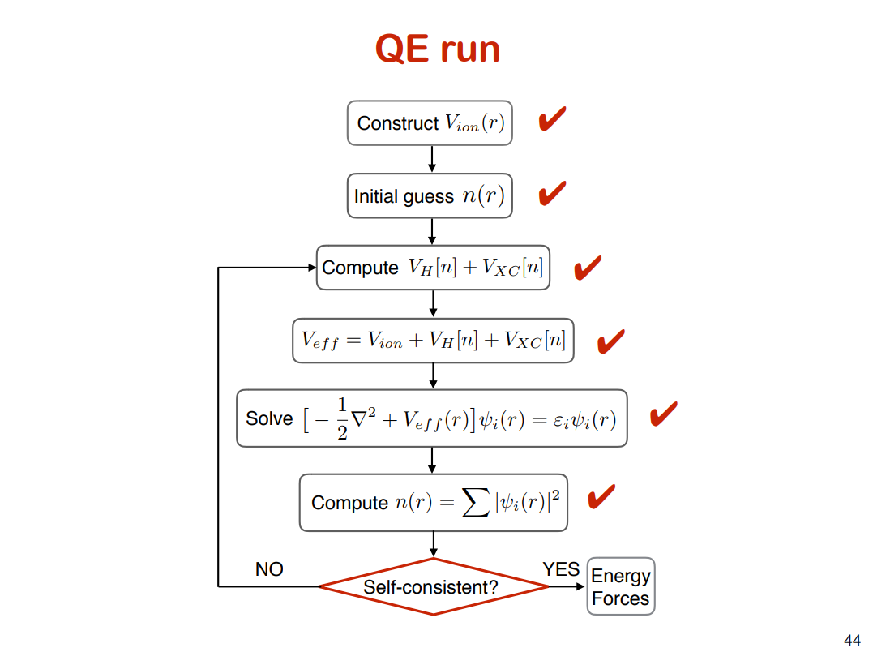

Slide 37
Self-consistency
&CONTROL
calculation='scf', restart_mode='from_scratch', prefix='si', pseudo_dir='../pseudo/', outdir='../tmp/',
/ &SYSTEM
ibrav=2, celldm(1)=10.2625, nat=2,
ntyp=1, ecutwfc=60.0, ecutrho=720.0,
/ &ELECTRONS
mixing_beta=0.7,
Convergence threshold for self-consistency: estimated energy error > conv_thr (NO)
or energy error < conv_thr (YES)
conv_thr=1d-8,
/ ATOMIC_SPECIES
Si 28.0855 Si.pbe-rrkj.UPF ATOMIC_POSITIONS (alat)
Si | 0.00 | 0.00 | 0.00
Si | 0.25 | 0.25 | 0.25
K_POINTS automatic 4 4 4 1 1 1

Slide 38
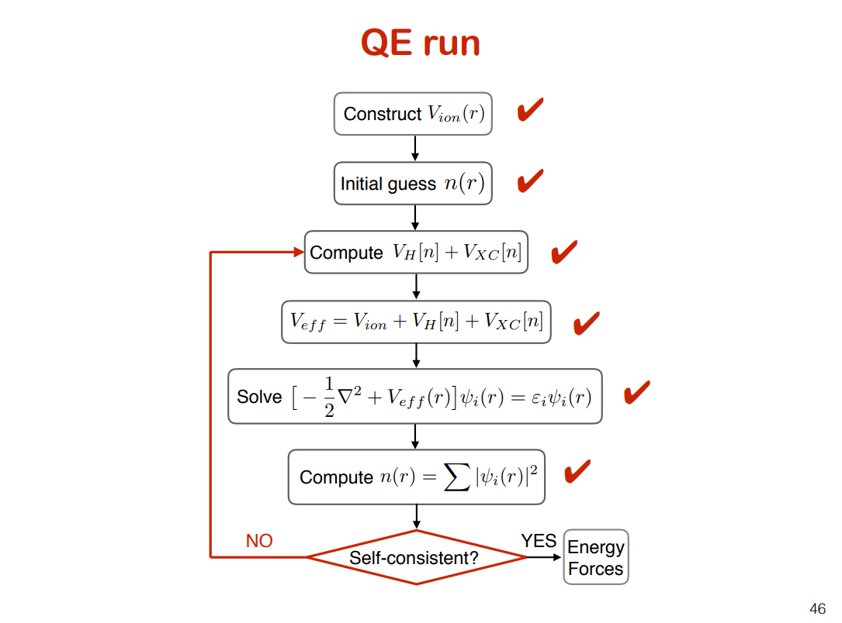

Slide 39
new n(r)
&CONTROL
calculation='scf', restart_mode='from_scratch', prefix='si', pseudo_dir='../pseudo/', outdir='../tmp/',
/ &SYSTEM
ibrav=2, celldm(1)=10.2625, nat=2,
ntyp=1, ecutwfc=60.0, ecutrho=720.0,
/
&ELECTRONS
Mix new and old density:
0.7 = 70% of the new density and 30% of old density at first step
mixing_beta=0.7,
conv_thr=1d-8,
/ ATOMIC_SPECIES
Si 28.0855 Si.pbe-rrkj.UPF ATOMIC_POSITIONS (alat)
Si | 0.00 | 0.00 | 0.00
Si | 0.25 | 0.25 | 0.25
K_POINTS automatic 4 4 4 1 1 1

Slide 40
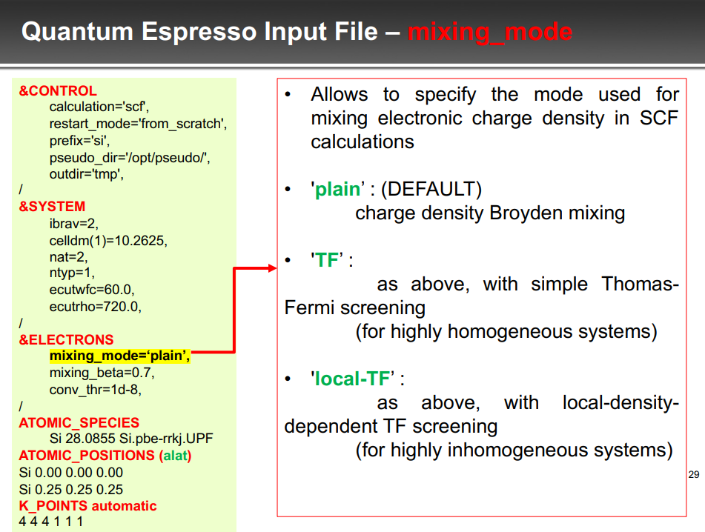

Slide 41
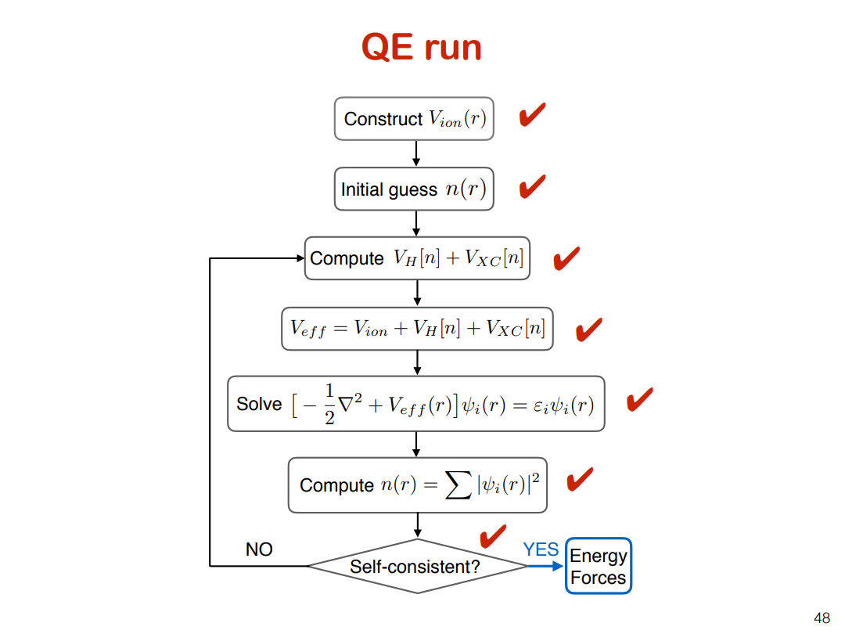

Slide 42
Forces & Geometry Optimization

Slide 43
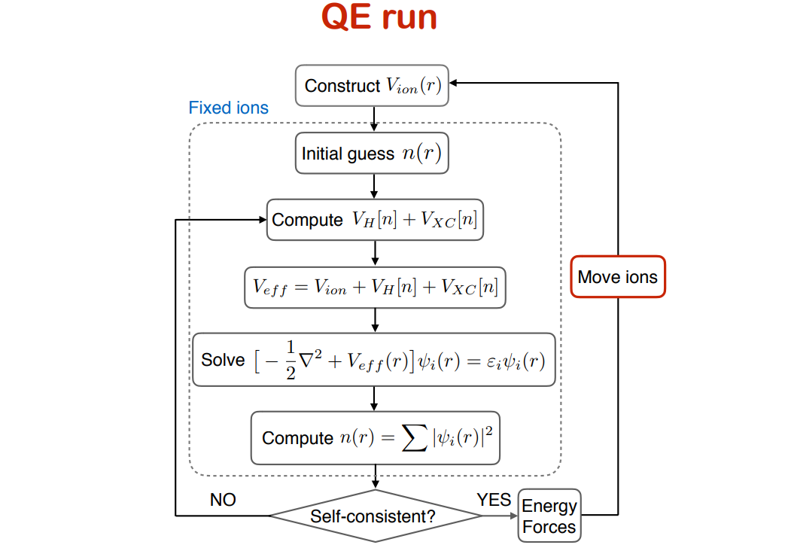
Inner SCF loop for electronic iterations
Outer loop for ionic iterations
Structure Optimized!
Forces =0?

Slide 44
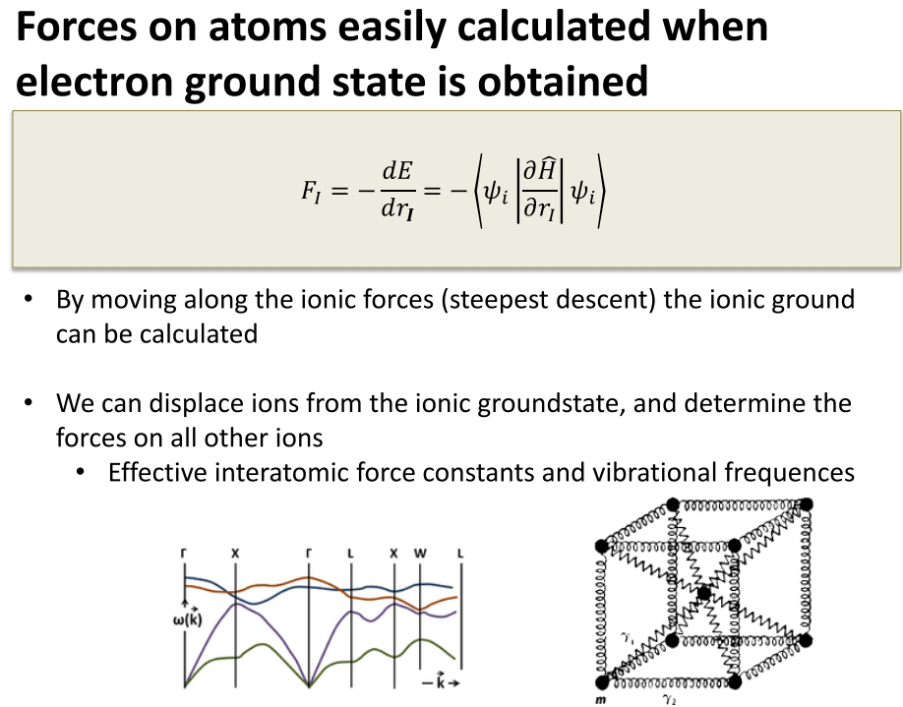

Slide 45
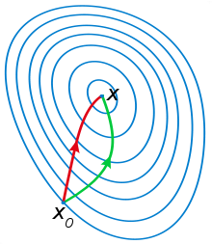
Structure optimization
&CONTROL
calculation=‘vc-relax',
restart_mode='from_scratch', prefix='si', pseudo_dir='../pseudo/', outdir=‘../tmp/',
forc_conv_thr=1d-5,
/ &SYSTEM
ibrav=2, celldm(1)=10.2625, nat=2,
ntyp=1, ecutwfc=60.0, ecutrho=720.0,
/ &ELECTRONS
mixing_beta=0.7, conv_thr=1d-8,
/
&IONS
Broyden–Fletcher–Goldfarb–Shanno (BFGS) algorithm is an iterative method for solving unconstrained nonlinear optimization problems.
ion_dynamics='bfgs',
/
&CELL
cell_dynamics='bfgs',
press=0.0,
press_conv_thr=0.5,
/ ATOMIC_SPECIES
Si 28.0855 Si.pbe-rrkj.UPF ATOMIC_POSITIONS (alat)
Si 0.00 0.00 0.00
Si 0.25 0.25 0.25
K_POINTS automatic 4 4 4 1 1 1

Slide 46
Structure optimization
&CONTROL
calculation=‘vc-relax',
restart_mode='from_scratch', prefix='si', pseudo_dir='../pseudo/', outdir=‘../tmp/',
forc_conv_thr=1d-5,
/ &SYSTEM
ibrav=2, celldm(1)=10.2625, nat=2,
ntyp=1, ecutwfc=60.0, ecutrho=720.0,
/ &ELECTRONS
mixing_beta=0.7, conv_thr=1d-8,
/
Cell lattice parameters and free (internal) coordinates of the atoms may be changed by relaxation
&IONS
ion_dynamics='bfgs',
/
&CELL
cell_dynamics='bfgs',
press=0.0,
press_conv_thr=0.5,
/ ATOMIC_SPECIES
Si 28.0855 Si.pbe-rrkj.UPF ATOMIC_POSITIONS (alat)
Si 0.00 0.00 0.00
Si 0.25 0.25 0.25
K_POINTS automatic 4 4 4 1 1 1

Slide 47
Properties Derived from the Ground State Energy
Second derivative of E_{tot} or F wrt Physical property
d_{i}, d_{i} (atomic displacement) Force spring const: phonons
E, E (E-field) Dielectric constant
ε, ε (strain) Elastic constant
E, ε Piezo-electric constant
E, d_{i} Born Dynamical charge
ε, d_{i} Strain-phonon coupling
H, H (magnetic field) Magnetic susceptibility
E, H Magneto-electric constant
H, ε Piezo-magnetic constant

